Slide 1
Advanced Research Methods foR Psychologists
Practical Applications in R

Slide 2
What is R?
R is free 🤑 and open source programming language for statistical computing and graphics 📈 (but can also do a lot more).

Slide 3
Why R?
Slowly replacing SPSS (🤮) as the go-to stats software in social-sci.
R is also significantly better than Excel for data analysis (which you should not use for data analysis!).
One of the top 10 programming languages in industry.
New statistical methods are implemented first in R!
often never available in commercial applications…
Highly extendable – over 10,000 community-developed packages📦.

Slide 4
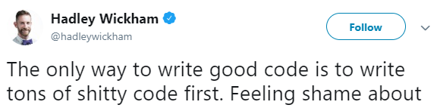
Why not R?
Requires coding 😱, with no point-and-click user interface.
Slow learning curve…
(I hope we can write some shitty code together)
Notes:
Who has any coding exp?

Slide 5
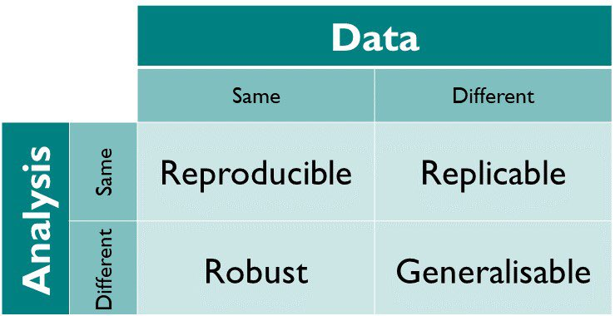

Why R after all?
Within R you can:
Prepare your data for analysis and plotting.
Model your data with all the familiar (and new!) stats model.
Create beautiful plots and figures.
(Even write you whole thesis / papers…)
Long term benefits:
All of this in a reproducible manner
Reuse code on new data - just copy and paste, with minor changes!
Learning to code is becoming a basic skill for many jobs (in and out of academia).
(Because you have to…🤷‍♂️)
Notes:
It’s really not that bad… https://psyarxiv.com/76w2p...

Slide 6
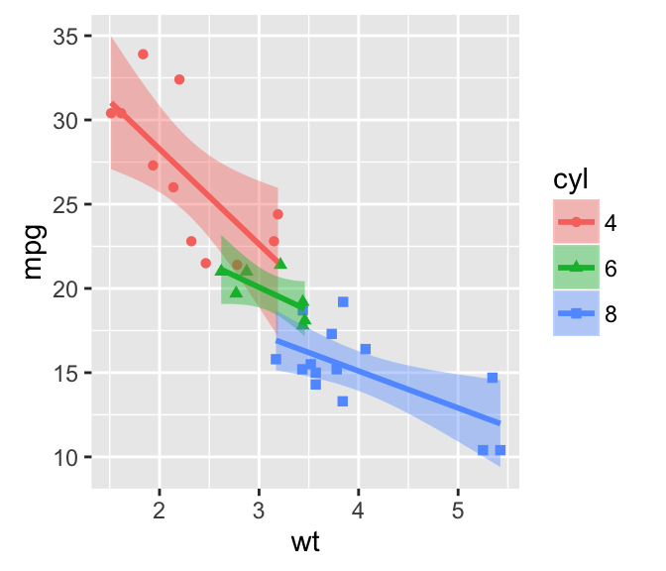


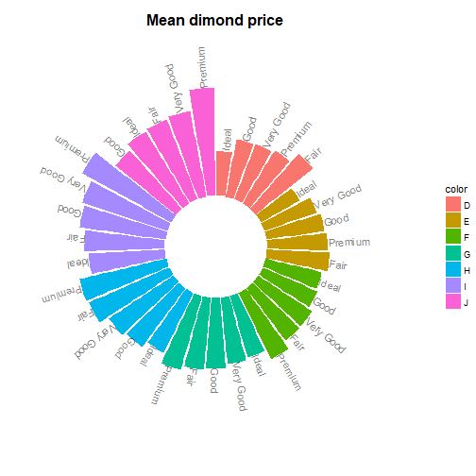
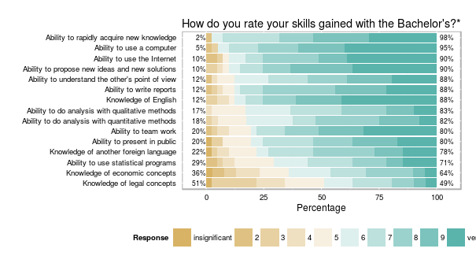
Why R after all?
https://www.instagram.com/thomasp85_/
R can also be used for writing- writing :
Papers and reports >>
CV written in R >>
Blogs >> (make your own!)

Slide 7
What you will learn
How to import data
How to prepare data
Summary statistics
Inferential statistics
Plotting

Slide 8
What you will NOT learn
How to make your code more efficient.
How to write your own packages.
You will also not learn everything…

Slide 9

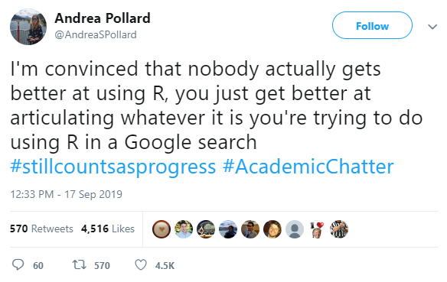

Resources
Free online books and courses
R for Data Science | r4ds.had.co.nz/
Learning Statistics with R | learningstatisticswithr.com/
Statistical Thinking for the 21st Century | statsthinking21.org/
R for Psychological Science | psyr.org/
Cheat sheets | rstudio.com/resources/cheatsheets/
Getting-help Guide | blog.rsquaredacademy.com/getting-help-in-r-updated/
Stay up-to-date | r-bloggers.com/

